Slide 1

ASM project presentation
Presented by
Nick Dahms, Josh Jolly, Tayler Silacci, Brandon Varao
Store: 3587, Market: 455, Region: 56
Division: 1

Slide 2
Problem
Turnover
Overall turnover: 135%
  Overnight stockers: 160%
  Cashiers: 130%
Some exacerbating factors of turnover:
  Students looking for seasonal jobs
  Few high schoolers are opting to work for Walmart – possibly because of work restrictions/obstacles
  Transfers out of the store increase turnover statistic (“Good turnover”)
Store of the Community profile
44.4% of adults are living in $100,000+ households, followed by 16.4% living in $50,000-74,999 house holds
Vast majority of shoppers (68.2%) have no children
Top 2 lifestyle characteristic are Affluent Urban Adults and Upper Midscale Urban Adults
Top Occupation of shopper is no civilian employment, at 45.9%, implying few shoppers are in need of work.
Notes:
The topic we decided to choose for our problem is turnover.
Within the first week of the internship program, the turnover rate for our store was 135% (the goal for every Walmart store is 80%).
The top 2 shifts that had the highest turnover were overnights (160%) and cashier (130%).
Some factors that could contribute to the high turnover are:
Students looking for seasonal jobs
Lack of employed minors
Transfers

Slide 3
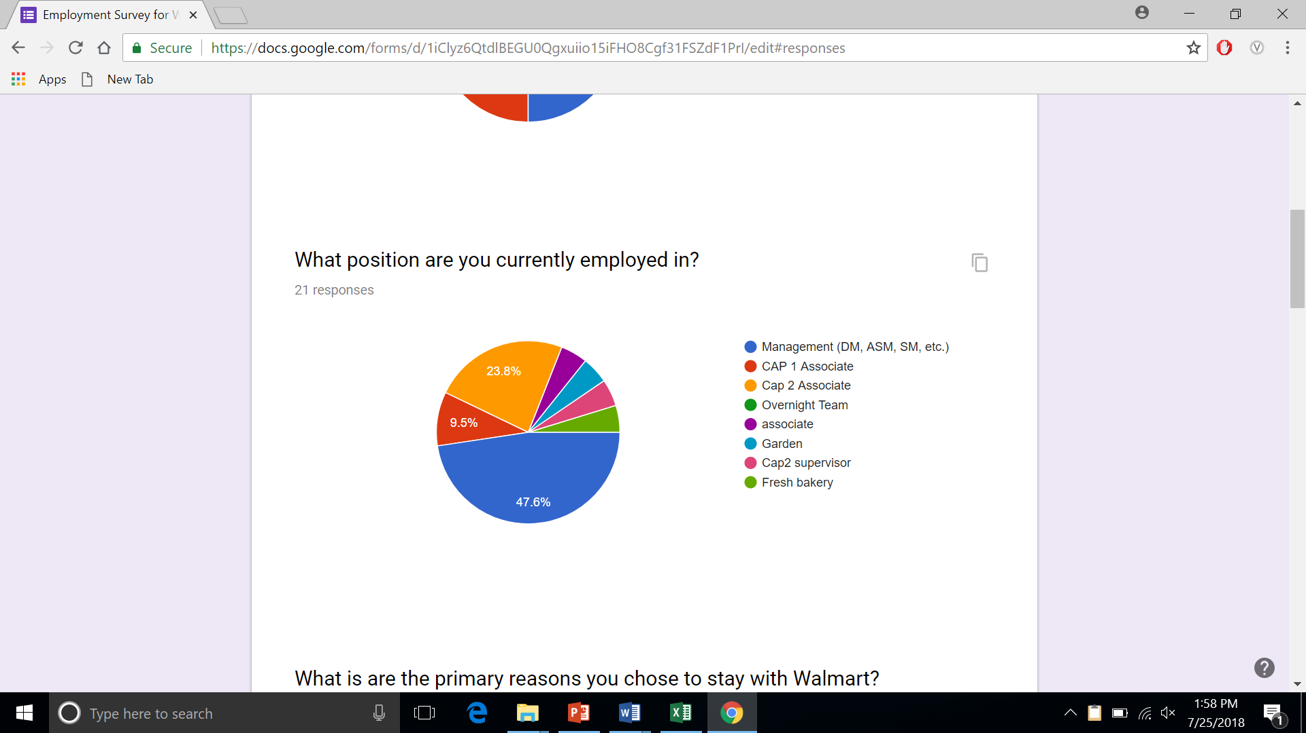
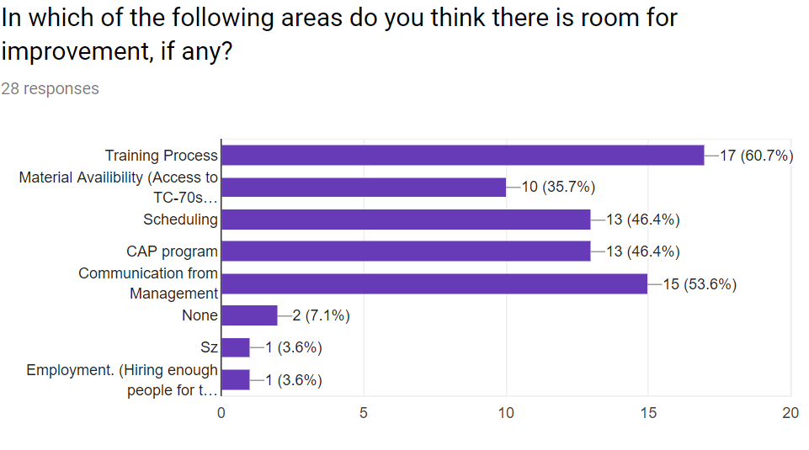
Survey
How Long have you been with Walmart?
  Turnover is highly concentrated in first year of employment.
What was the primary reason you stayed with Walmart?
  56% said potential for advancement. Other options were <15% each, including starting pay.
I am comfortable using the open door policy
  Only 60% comfortable. Newer associates are wary of using open door
Where is there room for improvement?
  Newer associates claimed training process/material availability, while older associates said scheduling/communication from management needed the most work.
Notes:
Some questions include:
How long have they been employed at Walmart?
How comfortable are they with approaching management?
What are the reasons they chose to stay at Walmart?
Is there any room for improvement?

Slide 4
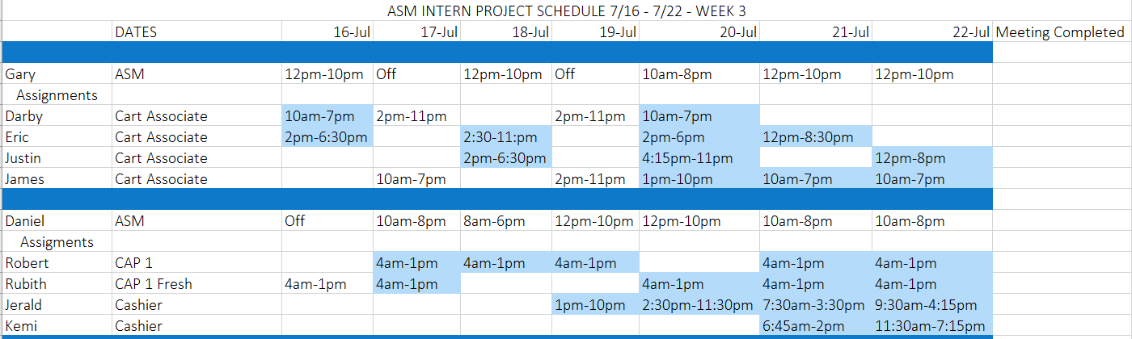
Our plan and implementation
Plan
ASM meet with new associates for 15 min once a week for one month
  Increase communication and help hires feel welcomed
Talking points
  Adjustment to sleep schedules
  Hobbies
  Associate Walmart experience
  ASM Walmart story
  What associate needs from ASM
Implementation
Linked new hires schedules with ASM
  Sent out weekly email reminders
  Followed up with ASM
  Created forms that ASM fill out
Notes:
Our plan was that the assistant store managers meet with their new associates once a week for 15 minutes from week 23 to week 26.
This would increase communication between managers and new hires so that the new hires feel welcome and stay longer.
In order to implement the solution, we had to find out when the managers’ and new associates’ schedule overlaps so they can meet.
Possible meeting topics include:

Slide 5
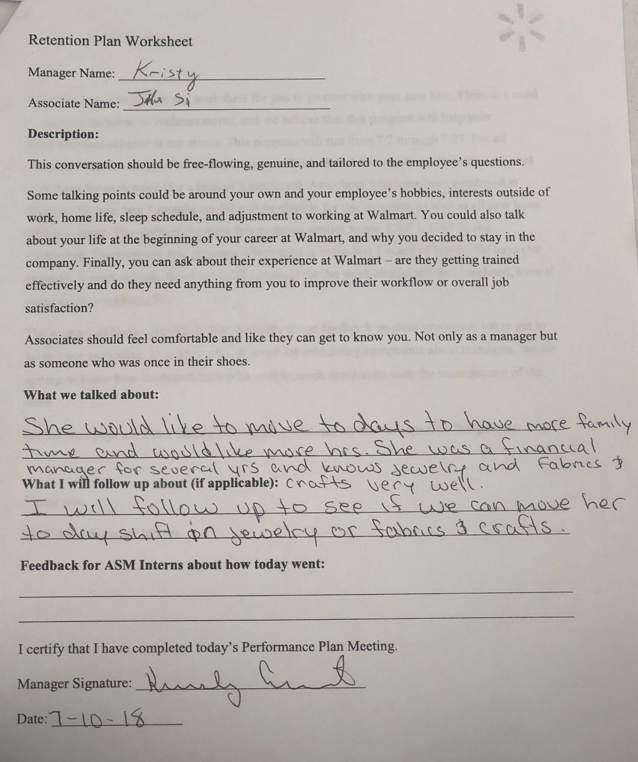
Results and feedback
The first week most ASMs completed their meetings
  Liked getting to know their associates
  Some conversations felt awkward
  Did not know what to talk about
After that, documentation was no longer filled out but meetings still continued
The most common themes we found is that most of the new hires wanted more or different hours.
Met with new associates and they felt the meetings were helpful to adjusting
Turnover rate for store 3587 is 128%.
Notes:
Turnover
Overnights: 120%
Cashiers: 114%

Slide 6
Recommendations
Need to include associates that just got promoted into new positions
With the recent pay raise, retention should be high priority because there’s a lot of competition in the area.
Have a better outlined talking point for each week meeting
Consider changing meeting times to once every 2 weeks
Better accountability system for ASMs

Slide 7
QUESTIONS?

Slide 8
Thank you

Slide 9
Extras
Survey methodologies
Survey questions??

